Slide 1

Fake Medicine is a Problem
700,000 deaths a year from fake malaria and tuberculosis drugs [1]
Equivalent of this many crashes per day
[1] http://www.un.org/africarenewal/magazine/may-2013/counterfeit-drugs-raise-africa%E2%80%99s-temperature

Slide 2
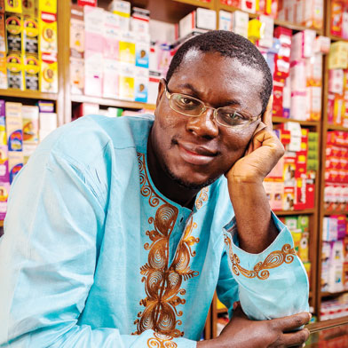
Chris’ Favorite Program
Bright Simons

Slide 3
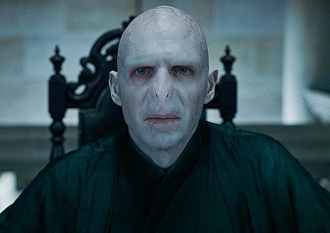
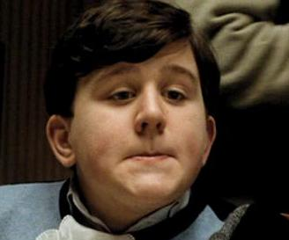
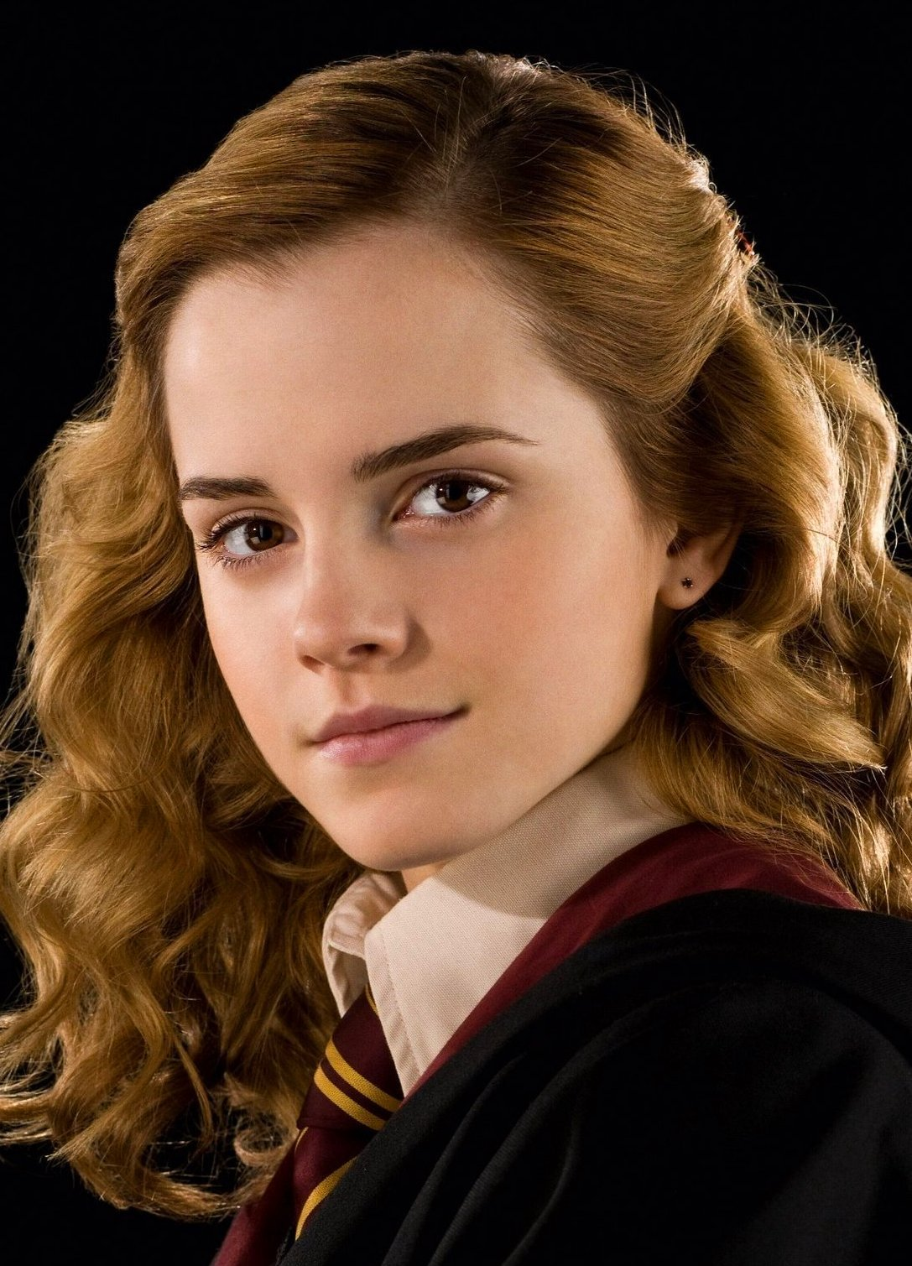
Underlying Puzzle
Counterfeiter
User
You (Distributor)

Slide 4
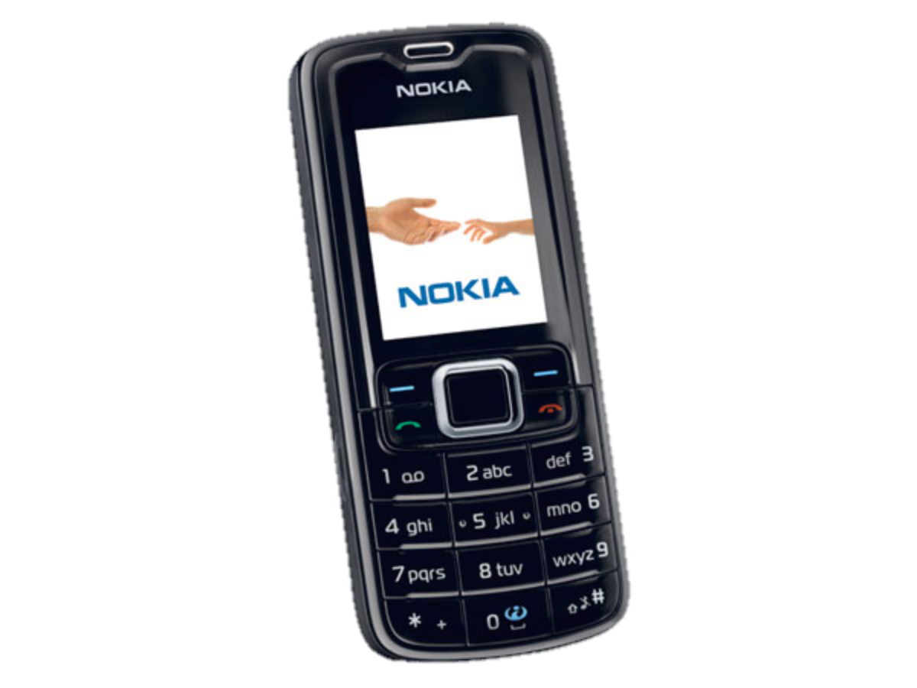
Underlying Puzzle
Counterfeiter
?
User
You (Distributor)

Slide 5
Underlying Puzzle
Counterfeiter
?
User
You (Distributor)

Slide 6
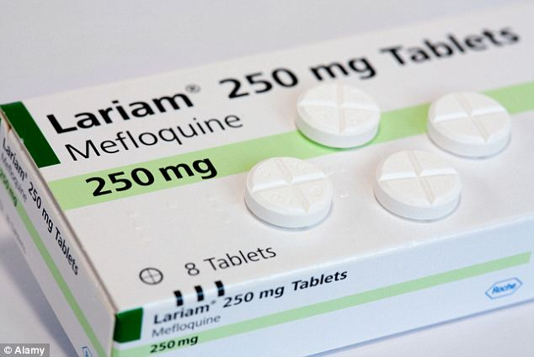
Real Life Challenge
Counterfeiter
?
User
You (Distributor)

Slide 7
Revisit this on Wednesday

Slide 8

Text Processing
Text Processing
Chris Piech
CS106A, Stanford University

Slide 9


Learning Goals
Be able to perform math operations on chars
Be able to write string algorithms that loops over each character

Slide 10
Text Problem: Decryption
Joan Clarke
Alan Turing

Slide 11
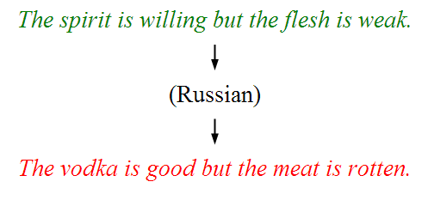
Text Problem: Translation

Slide 12
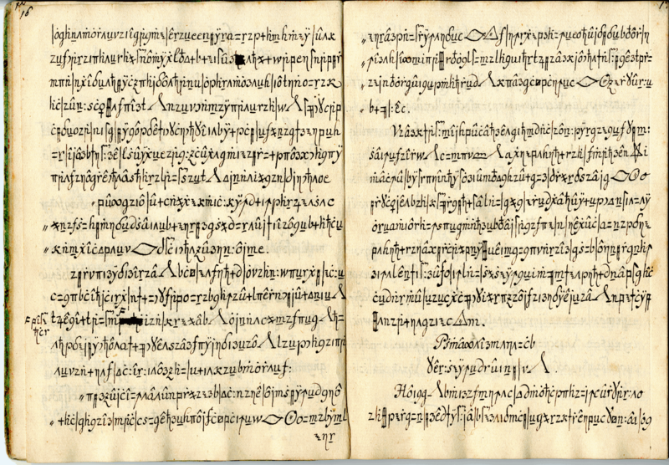
Related problems
http://www.nytimes.com/2011/10/25/science/25code.html

Slide 13
A string is a sequence of characters.
The variable type String
public void run() {
String text = “hello!”;
}
Notes:
Write code that reads in a line of text from the user and echoes it back. First, do “Nubian Ibex”

Slide 14
H
e
l
l
o
!
Notes:
Strings are made of characters.

Slide 15
H
e
l
l
o
!
0
1
2
3
4
5

Slide 16
public void run() {
String text = “hello!”;
}
stack
heap
run
28
text
28
H
e
l
l
o
!

Slide 17
H
e
l
l
o
!
0
1
2
3
4
5
text.charAt(index)

Slide 18
How are characters
represented?

Slide 19
The variable type char
The primitive type char represents a single character or glyph.
Some examples:
char letterA = 'A';
char plus = '+'
char zero = '0';
char space = ' ';
char newLine = '\n'; // special
char first = text.charAt(0);

Slide 21
Enumeration
public static final int FROSH = 1;
public static final int SOPHOMORE = 2;
public static final int JUNIOR = 3;
public static final int SENIOR = 4;
public static final int OTHER = 5;
private int askForYear() {
while (true) {
int year = readInt("Enter class year: ");
if (year >= FROSH && year <= OTHER) return year;
}
}

Slide 22
Print Populations
private void printPopulation() {
for(int year = FROSH; year <= SENIOR; year++) {
println(countStudents(year));
}
}

Slide 23
Chars are just a giant enumeration.

Slide 24
ASCII
* This is only the first half of the table
The letter A, for example, has the Unicode value 101₈, which is the sum of the row and column labels.
Using portions of slides by Eric Roberts

Slide 25
‘A’ -> ‘Z’ are sequential.
‘a’ -> ‘z’ are sequential.
‘0’ -> ‘9’ are sequential.

Slide 26
toUpperCase

Slide 27
Useful Character methods
static boolean isDigit(char ch)
Determines if the specified character is a digit.
static boolean isLetter(char ch)
Determines if the specified character is a letter.
static boolean isLetterOrDigit(char ch)
Determines if the specified character is a letter or a digit.
static boolean isLowerCase(char ch)
Determines if the specified character is a lowercase letter.
static boolean isUpperCase(char ch)
Determines if the specified character is an uppercase letter.
static boolean isWhitespace(char ch)
Determines if the specified character is whitespace (spaces and tabs).
static char toLowerCase(char ch)
Converts ch to its lowercase equivalent, if any. If not, ch is returned unchanged.
static char toUpperCase(char ch)
Converts ch to its uppercase equivalent, if any. If not, ch is returned unchanged.
Using portions of slides by Eric Roberts

Slide 28
Useful Character methods
public void run() {
String str = readLine("Line: ");
char ch = str.charAt(0);
println("Original first char: " + ch);
ch = Character.toUpperCase(ch);
println("Uppercase first char: " + ch);
}

Slide 29
Looping with Strings
Because each character in a string occupies a particular index, you can visit all the characters in a string one at a time using a loop.
Canonical “loop over the characters in a string” loop:
for (int i = 0; i < string.length(); i++) {
char ch = string.charAt(i);
/* … process ch … */
}
The string.length() method returns the number of characters in the string. This is one larger than the last valid index in the string.
H
i
m
o
m
(length 6)
0
1
2
3
4
5
Notes:
Review the ourPrintln method, which prints one character at a time.

Slide 30
numUppercase

Slide 31
Strings have some unique properties

Slide 33
Strings are often made through concatenation
public void run() {
String s1 = "CS106";
String s2 = "A";
String s3 = "I got an " + s2 + " in " + s1 + s2;
println(s3);
}
I got an A in CS106A

Slide 35
Strings are Immutable
Java strings are immutable: once a string has been created, its contents cannot change.
To change a string:
Create a new string holding the new value you want it to have.
Reassign the String variable to hold the new value.
Important consequence: if you pass a String into a method, that method cannot modify that string.
Notes:
Show off toUpperCase and toLowerCase. Show that they don't actually modify the string because strings are immutable.

Slide 36
Many string algorithms use the “loop and construct” pattern.

Slide 38
Reversing a String
H
e
l
l
o
!

Slide 39
Reversing a String
H
e
l
l
o
!
!

Slide 40
Reversing a String
H
e
l
l
o
!
!

Slide 41
Reversing a String
H
e
l
l
o
!
!
o

Slide 42
Reversing a String
H
e
l
l
o
!
!
o

Slide 43
Reversing a String
H
e
l
l
o
!
!
o
l

Slide 44
Reversing a String
H
e
l
l
o
!
!
o
l

Slide 45
Reversing a String
H
e
l
l
o
!
!
o
l
l

Slide 46
Reversing a String
H
e
l
l
o
!
!
o
l
l

Slide 47
Reversing a String
H
e
l
l
o
!
!
o
l
l
e

Slide 48
Reversing a String
H
e
l
l
o
!
!
o
l
l
e

Slide 49
Reversing a String
H
e
l
l
o
!
!
o
l
l
e
H

Slide 50
Reversing a String
H
e
l
l
o
!
!
o
l
l
e
H
Notes:
Code up reverseString
for (int i = string.length() - 1; i ≥ 0; i--) {
result += string.charAt(i);
}

Slide 51
Reversing a String
H
e
l
l
o
!

Slide 52
Reversing a String
H
e
l
l
o
!
H

Slide 53
Reversing a String
H
e
l
l
o
!
e
H

Slide 54
Reversing a String
H
e
l
l
o
!
l
e
H

Slide 55
Reversing a String
H
e
l
l
o
!
l
l
e
H

Slide 56
Reversing a String
H
e
l
l
o
!
o
l
l
e
H

Slide 57
Reversing a String
H
e
l
l
o
!
!
o
l
l
e
H

Slide 58

reverseString
public void run() {
println("This program reverses a string.");
String str = readLine("Enter a string: ");
String rev = reverseString(str);
println(str + " spelled backwards is " + rev);
}
private String reverseString(String str) {
String result = "";
for ( int i = 0; i < str.length(); i++ ) {
result = str.charAt(i) + result;
}
return result;
}
rev
str
DESSERTS
STRESSED
result
str
i
STRESSED
0
1
2
3
4
5
7
8
S
6
TS
RTS
ERTS
SERTS
SSERTS
ESSERTS
DESSERTS
ReverseString
This program reverses a string.
STRESSED
Enter a string:
STRESSED spelled backwards is DESSERTS
Using portions of slides by Eric Roberts
skip simulation

Slide 59
Useful String methods
int length()
Returns the length of the string
char charAt(int index)
Returns the character at the specified index. Note: Strings indexed starting at 0.
String substring(int p1, int p2)
Returns the substring beginning at p1 and extending up to but not including p2
String substring(int p1)
Returns substring beginning at p1 and extending through end of string.
boolean equals(String s2)
Returns true if string s2 is equal to the receiver string. This is case sensitive.
int compareTo(String s2)
Returns integer whose sign indicates how strings compare in lexicographic order
int indexOf(char ch) or int indexOf(String s)
Returns index of first occurrence of the character or the string, or -1 if not found
String toLowerCase() or String toUpperCase()
Returns a lowercase or uppercase version of the receiver string
Using portions of slides by Eric Roberts

Slide 60
Palindrome
A palindrome is a string that reads the same forwards and backwards.
For example:
Racecar
Kayak
Mr. Owl ate my metal worm.
Go hang a salami! I'm a lasagna hog.
Elu par cette crapule

Slide 61
What went wrong?

Slide 62
Use .equals to compare strings, not ==

Slide 63
Some test cases
Let's test our program on some examples:
Racecar
Kayak
Mr. Owl ate my metal worm.
Go hang a salami! I'm a lasagna hog.
Will it work?
Notes:
This isn't going to work. Why not? Go to the board – are these strings really equal to their reverses?
Need to convert to lower case, for starters. Then, need to strip out everything besides letters.

Slide 64
A man, a plan, a caret, a ban, a myriad, a sum, a lac, a liar, a hoop, a pint, a catalpa, a gas, an oil, a bird, a yell, a vat, a caw, a pax, a wag, a tax, a nay, a ram, a cap, a yam, a gay, a tsar, a wall, a car, a luger, a ward, a bin, a woman, a vassal, a wolf, a tuna, a nit, a pall, a fret, a watt, a bay, a daub, a tan, a cab, a datum, a gall, a hat, a tag, a zap, a say, a jaw, a lay, a wet, a gallop, a tug, a trot, a trap, a tram, a torr, a caper, a top, a tonk, a toll, a ball, a fair, a sax, a minim, a tenor, a bass, a passer, a capital, a rut, an amen, a ted, a cabal, a tang, a sun, an ass, a maw, a sag, a jam, a dam, a sub, a salt, an axon, a sail, an ad, a wadi, a radian, a room, a rood, a rip, a tad, a pariah, a revel, a reel, a reed, a pool, a plug, a pin, a peek, a parabola, a dog, a pat, a cud, a nu, a fan, a pal, a rum, a nod, an eta, a lag, an eel, a batik, a mug, a mot, a nap, a maxim, a mood, a leek, a grub, a gob, a gel, a drab, a citadel, a total, a cedar, a tap, a gag, a rat, a manor, a bar, a gal, a cola, a pap, a yaw, a tab, a raj, a gab, a nag, a pagan, a bag, a jar, a bat, a way, a papa, a local, a gar, a baron, a mat, a rag, a gap, a tar, a decal, a tot, a led, a tic, a bard, a leg, a bog, a burg, a keel, a doom, a mix, a map, an atom, a gum, a kit, a baleen, a gala, a ten, a don, a mural, a pan, a faun, a ducat, a pagoda, a lob, a rap, a keep, a nip, a gulp, a loop, a deer, a leer, a lever, a hair, a pad, a tapir, a door, a moor, an aid, a raid, a wad, an alias, an ox, an atlas, a bus, a madam, a jag, a saw, a mass, an anus, a gnat, a lab, a cadet, an em, a natural, a tip, a caress, a pass, a baronet, a minimax, a sari, a fall, a ballot, a knot, a pot, a rep, a carrot, a mart, a part, a tort, a gut, a poll, a gateway, a law, a jay, a sap, a zag, a tat, a hall, a gamut, a dab, a can, a tabu, a day, a batt, a waterfall, a patina, a nut, a flow, a lass, a van, a mow, a nib, a draw, a regular, a call, a war, a stay, a gam, a yap, a cam, a ray, an ax, a tag, a wax, a paw, a cat, a valley, a drib, a lion, a saga, a plat, a catnip, a pooh, a rail, a calamus, a dairyman, a bater, a canal – Panama!
Notes:
Try this in our checker – it should work!

Slide 65
Remember!
Counterfeiter
?
User
You (Distributor)

Slide 66
Can you solve it?
Bright Simons

